Slide 1

Customer Shopping Behavior Analysis
3,900 purchases | 18 features | Objective: uncover spending patterns, segments, preferences

Slide 2

Dataset Summary
Rows & Columns
Key Features
3,900 rows · 18 columns
Demographics, Purchase details, Behavior
Missing Data
37 missing review ratings

Slide 3

Exploratory Data Analysis (Python)
Load & Inspect
df.info(), df.describe()
Missing Handling
Imputed review_rating by category median
Standardize
Renamed columns to snake_case
Feature Eng.
age_group, purchase_frequency_days

Slide 4
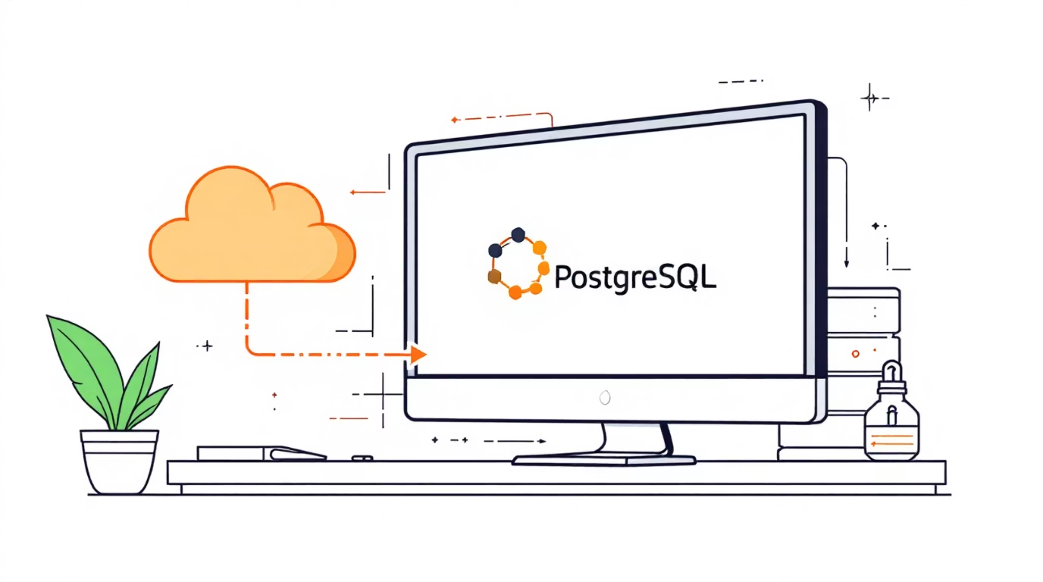
Database Integration
Connected cleaned DataFrame to PostgreSQL for SQL analysis
Dropped Column
promo_code_used (redundant with discount_applied)
Verification
Data consistency checks completed

Slide 5
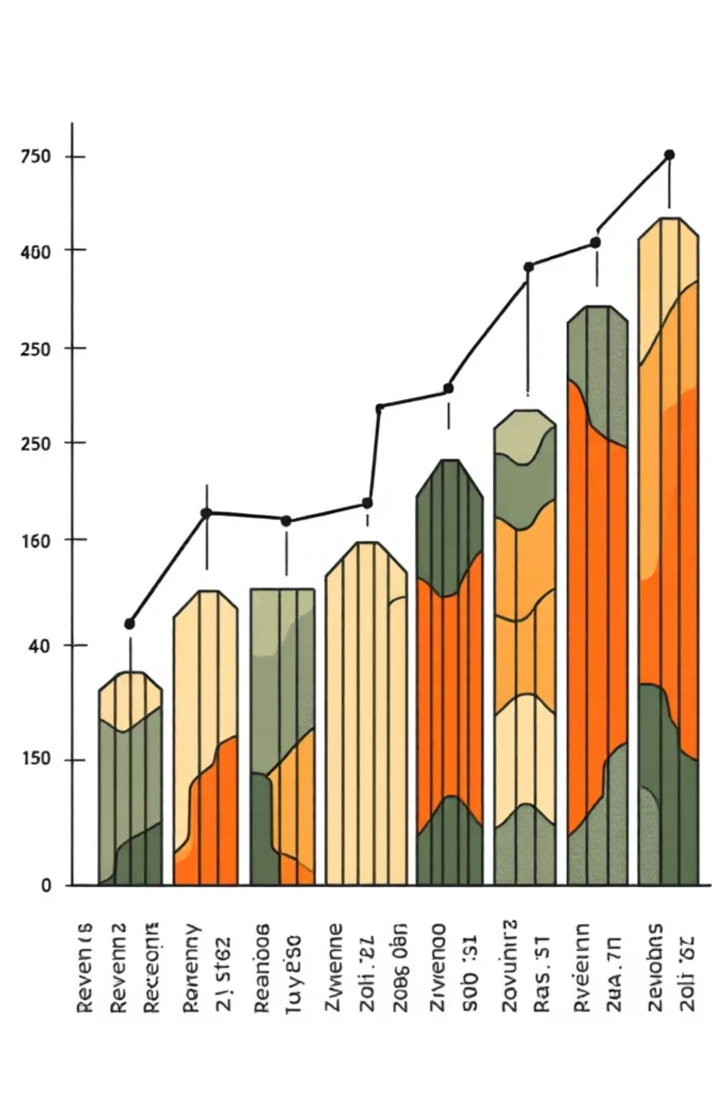
Revenue by Gender
1
2
Male
Female
$157,890 total revenue
$75,191 total revenue

Slide 6
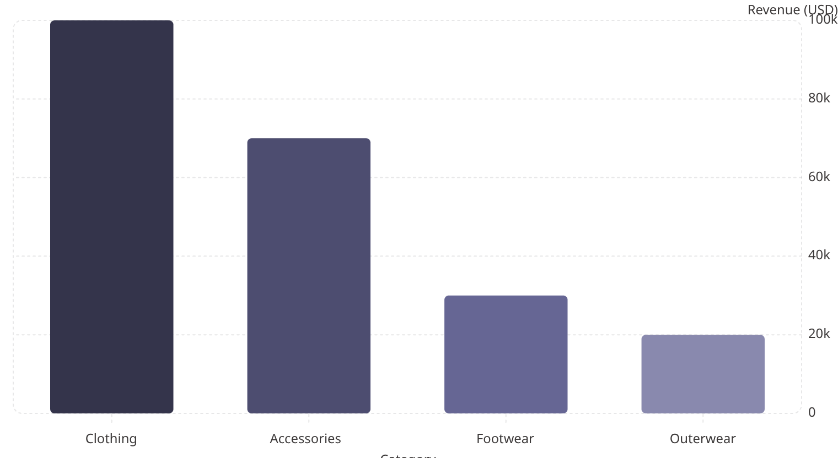

Revenue by Category
Clothing leads revenue. Use for campaign prioritization.
Key metric: Avg purchase amount $59.76 · 3.9K customers

Slide 7

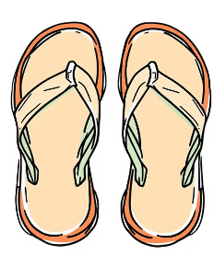
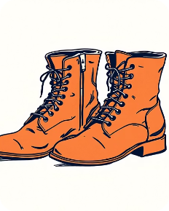


Top Products by Rating
Gloves
Sandals
Boots
Hat
Avg rating 3.86
Avg rating 3.84
Avg rating 3.82
Avg rating 3.80
Skirt
Avg rating 3.78

Slide 8
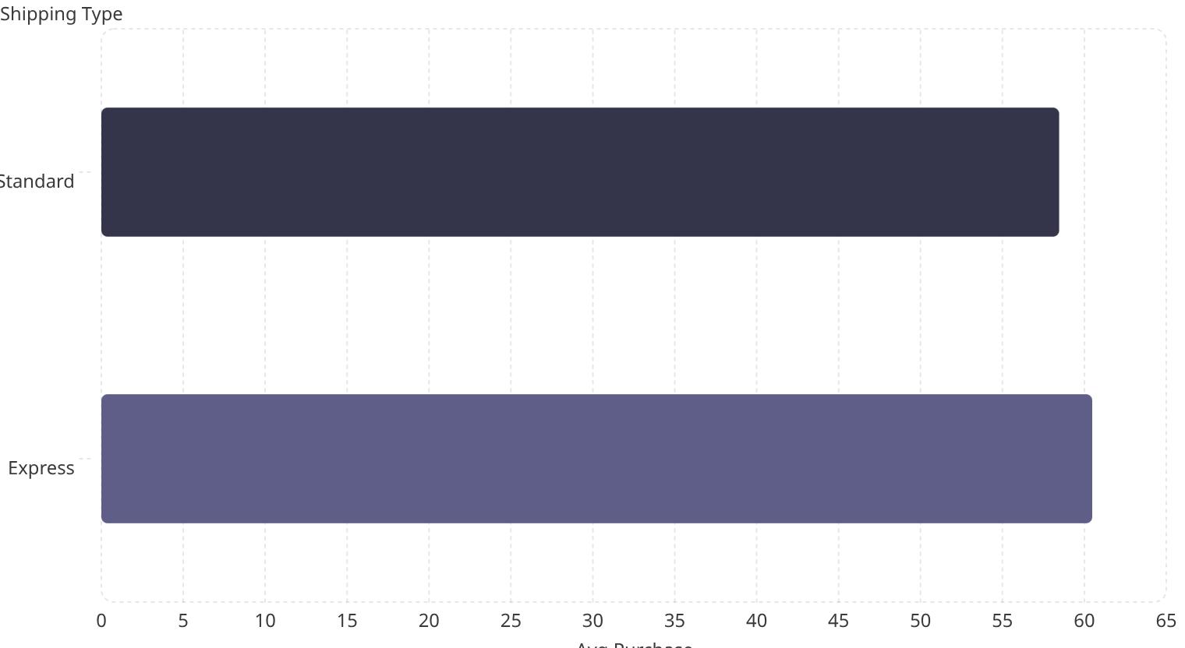
Shipping Comparison
Express slightly higher avg purchase. Consider targeting express users.
Shipping Types
Standard, Express, Free, Next Day, Store Pickup

Slide 9

Dashboard Highlights (Power BI)
3.9K
$59.76
3.75
Customers
Avg Purchase
Avg Rating
% Subscribers: Yes 27% · No 73%

Slide 10

Business Recommendations
Boost Subscriptions
Loyalty Programs
Review Discounts
Promote exclusive subscriber benefits
Reward repeat buyers to grow 'Loyal' segment
Balance sales with margin control
Product Positioning
Targeted Marketing
Promote top-rated & best-selling items
Focus on high-revenue age groups & express users

